Slide 1
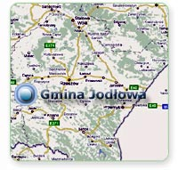
Poland is cool jodłowa is beautiful
Jodłowa - a village (formerly a town ) in the south – east of Poland, located in the Podkarpackie Province

Slide 2
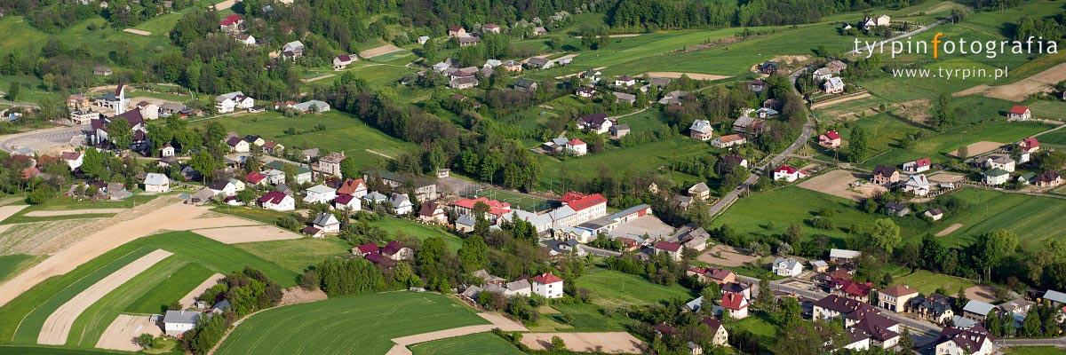
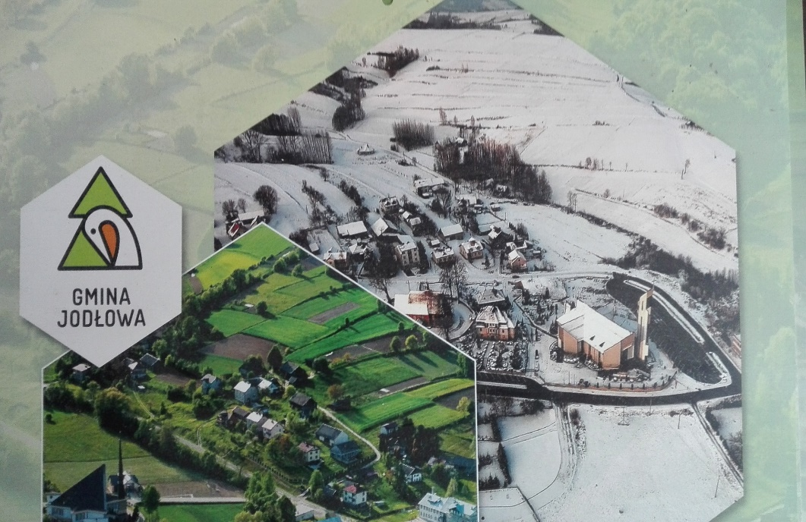
history
Jodłowa was first mentioned in documents from 1354. It consist of 7 parts:
Jodłowa Górna, Jodłowa Dolna, Wisowa, Dębowa, Zagórze, Dęborzyn and Dzwonowa.

Slide 3


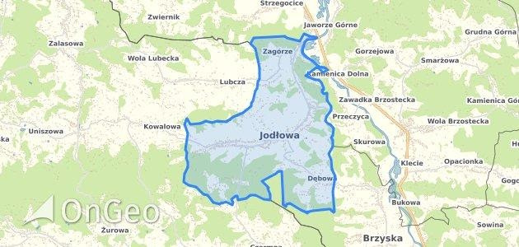
Coat of arms and location

Slide 4
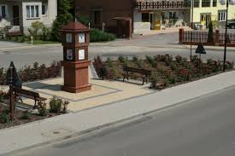
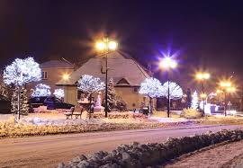
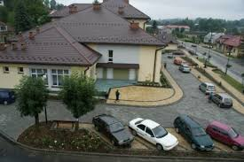
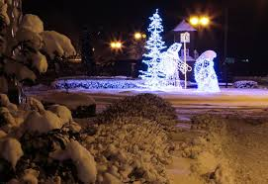
Tourists Attractions
Town square

Slide 5
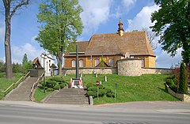
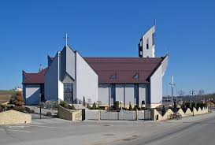
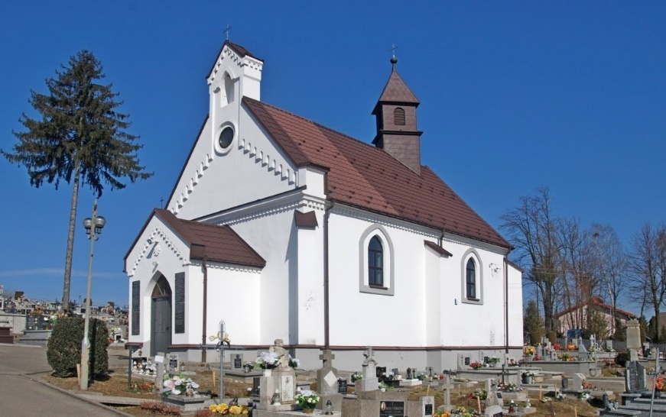
churches
Jesus Child Sanctuary
The first mention of the parish comes from 1475.
Saint Stanislaus Church
Cemetery chapel

Slide 6
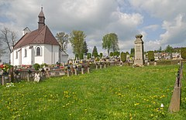
War cemetery No. 231 in Jodłowa
It is located in the center of Jodłowa, next to the parish cemetery. In the central part there is a stone monument topped with a candle.

Slide 7
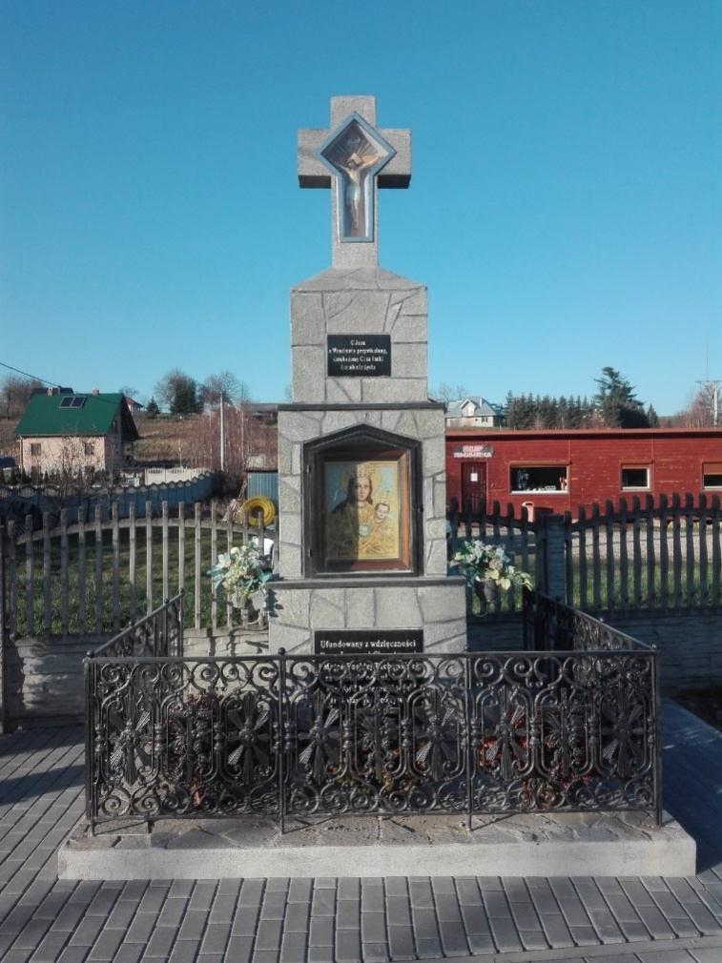
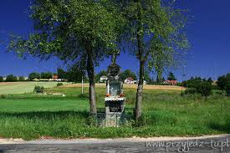
Monuments
There are a lot of monuments like monument dedicated to the memory of the heroes called „Pomnik Wrocławski”. On the right you can see it renovated.

Slide 8
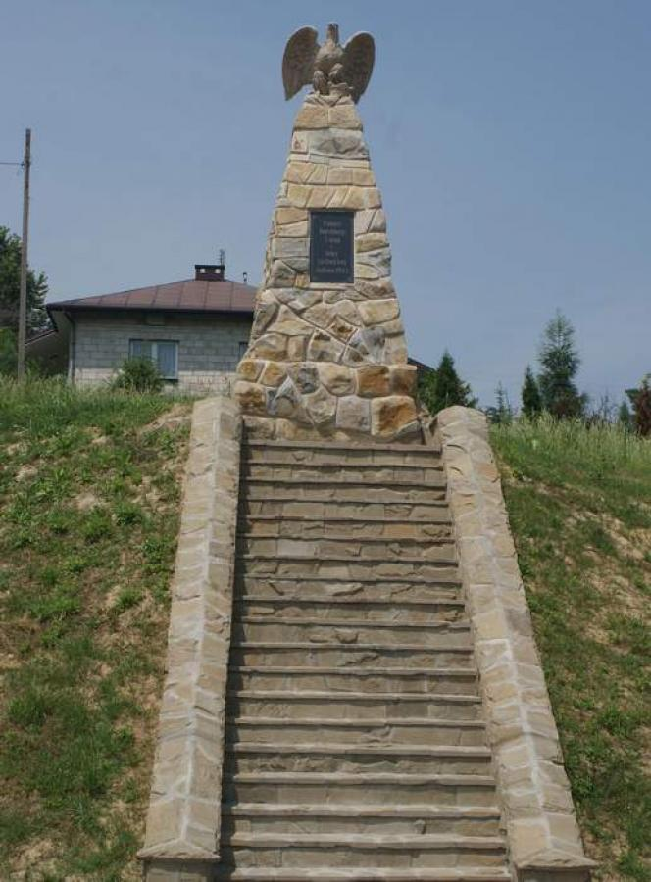
Grunwald Monument
The Grunwald Monument and the Constitution of May 3, the construction of which began in 1910 - the 500th anniversary of the Battle of Grunwald - unveiled on May 3, 1914

Slide 9
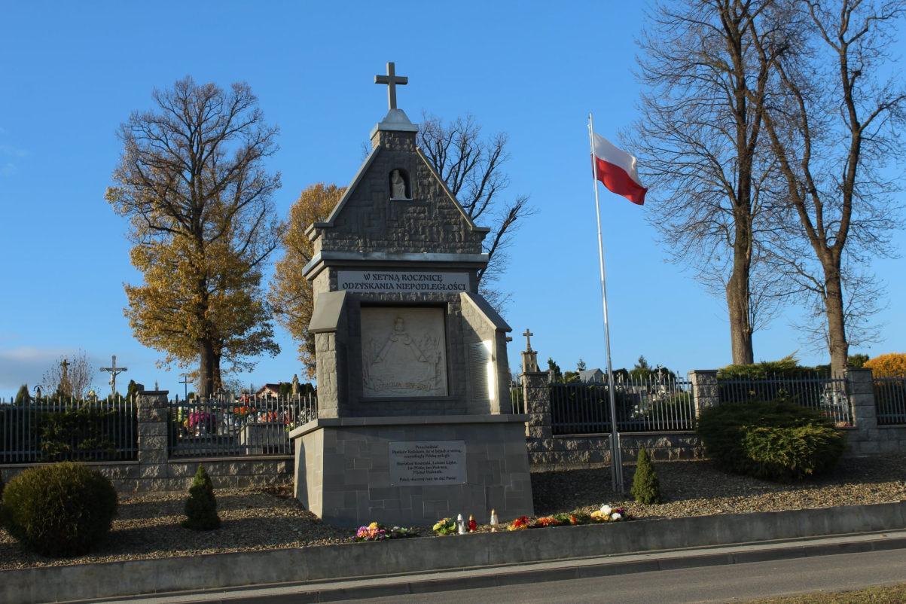
a monument to independence
The chapel stood next to the cemetery between the fence and the pavement. Its shape resembles the facade of the church in the cemetery. Its height is over 5 meters.

Slide 10
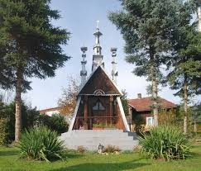
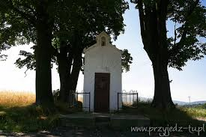
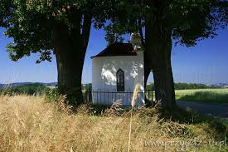
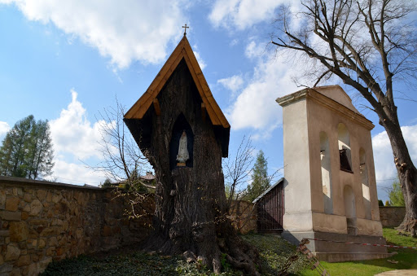
There are a lot of old crosses and shrines.

Slide 11
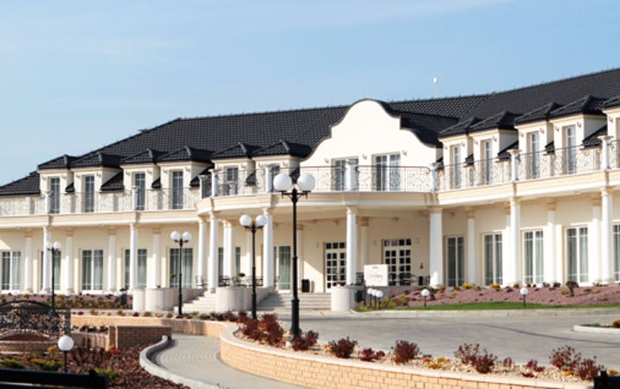
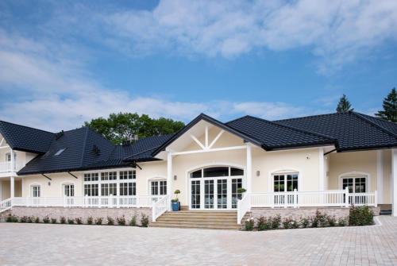
We have got well-known restaurants and hotels.
Jodłowy Dwór „In the old garden” Restaurant

Slide 12
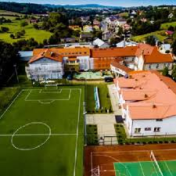
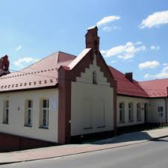
And this is our school.
It’s Primary School No.1 in Jodłowa. There are 263 students.
We have got Orlik, a gym and a playground.

Slide 13
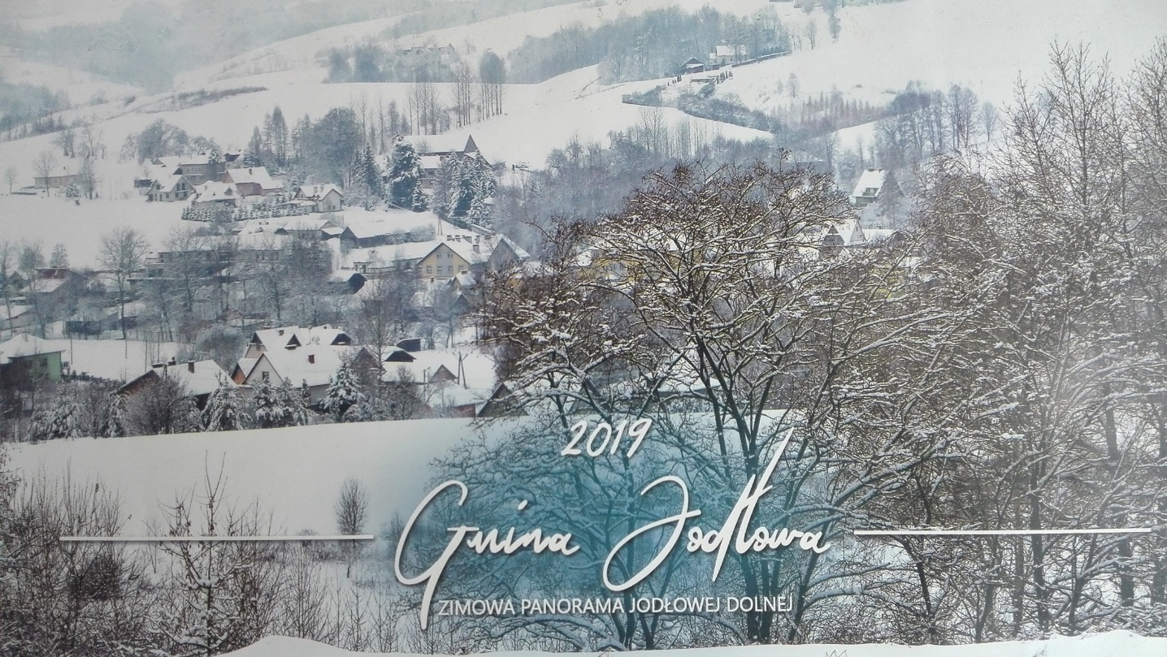
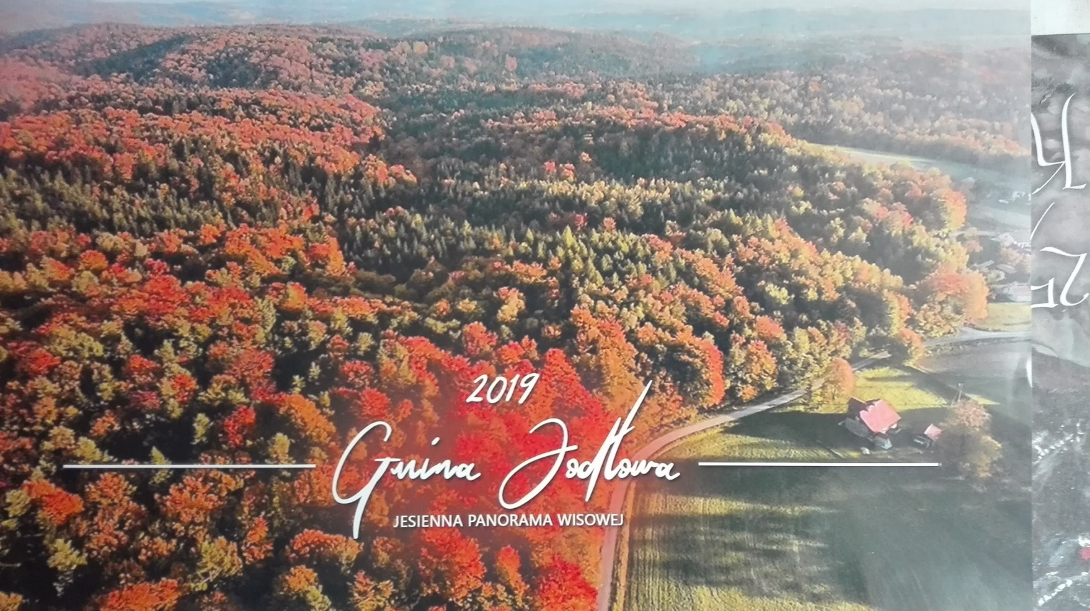
In Jodłowa there are a lot of hills, beautiful forests and views.

Slide 14
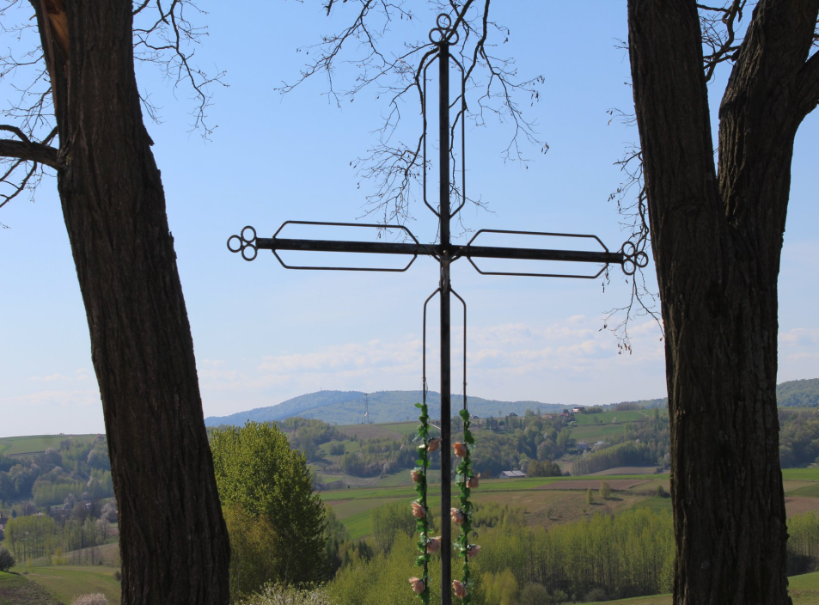
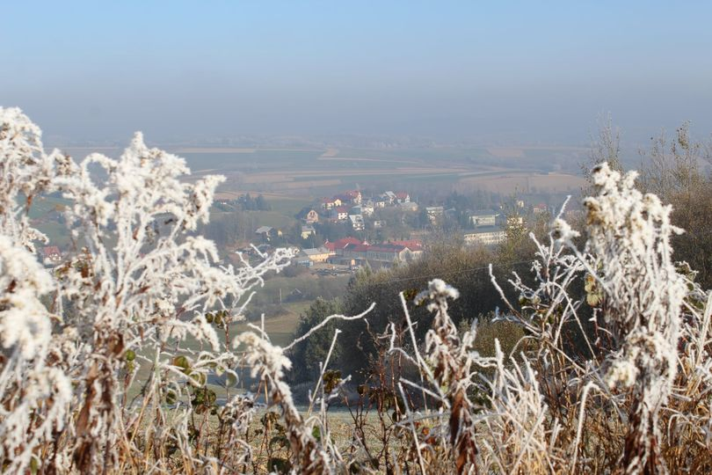
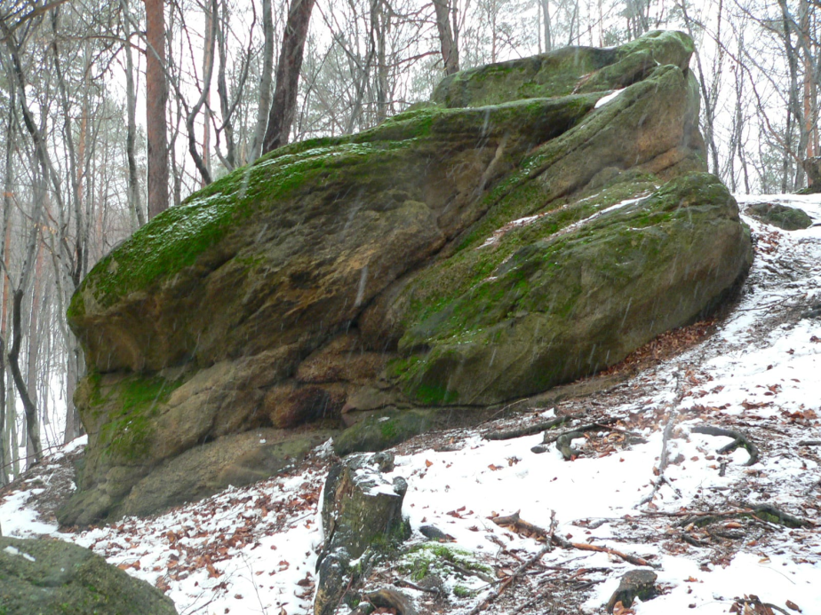
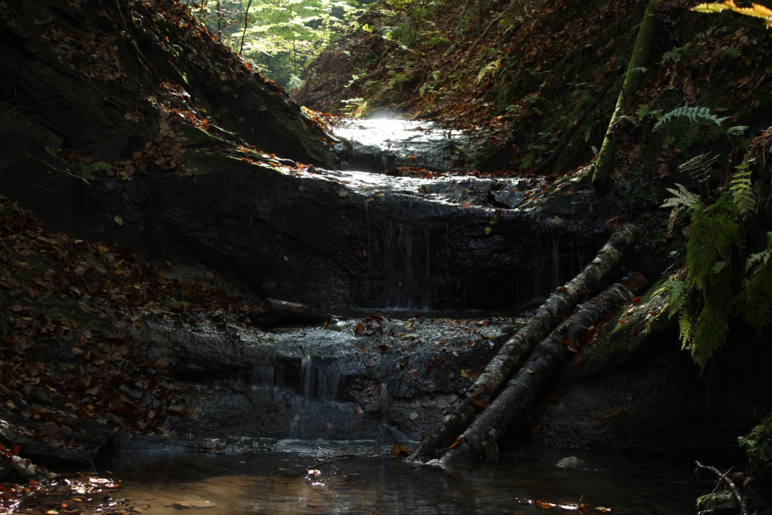

Slide 15
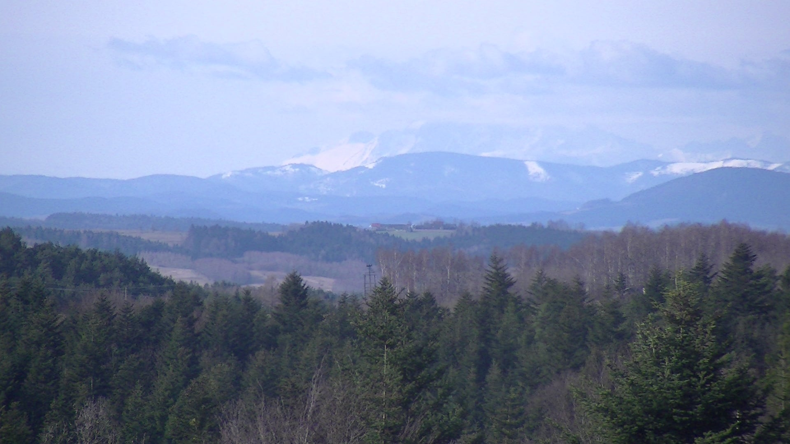
If you are lucky you can see the Tatra Mountains from Wisowa!

Slide 16
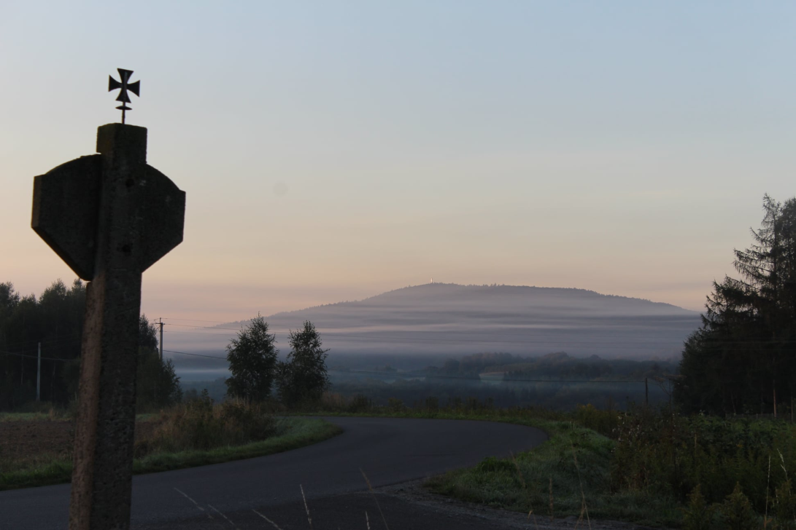
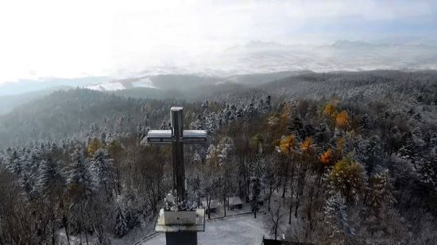
In the background you can see a big cross located on Liwocz – the highest point in Brzyska. There is a viewing platform.

Slide 17
Thank You !
Klasa IV b
Szkoła Podstawowa Nr 1 im. ks. Franciszka Blachnickiego w Jodłowej
Nauczyciel - Barbara Wójcik
Project is based on Zuzia’s presentation.

